Slide 1
A SERMON
I Am.
Don't Be Afraid.
Matthew 14:22–33 · NRSVUE
Notes:
OPERATOR: This slide should be live before the pastor begins speaking. Advance to Slide 2 when the pastor says: "Jesus finally gets his moment... he makes the disciples get into the boat."

Slide 2
THE SETUP
Immediately he made the disciples get into the boat… and after he had sent the crowds away, he went up the mountain by himself to pray.
MATTHEW 14:22–23
Notes:
OPERATOR: Advance to Slide 3 when the pastor says: "Meanwhile, out on the water, things have gone bad."

Slide 3
THE STORM
The boat, battered by the waves, was far from the land, for the wind was against them.
MATTHEW 14:24
Notes:
OPERATOR: Advance to Slide 4 right as the pastor lands on: "Take heart. It is I. Do not be afraid."

Slide 4
I AM
“Take heart, it is I; do not be afraid.”
MATTHEW 14:27
Notes:
OPERATOR: Advance to Slide 5 as the pastor reads Peter's line: "Lord, if it is you, command me to come to you on the water."

Slide 5
THE TEST
“Lord, if it is you, command me to come to you on the water.”
MATTHEW 14:28
Notes:
OPERATOR: Advance to Slide 6 when the pastor reaches the cry: "Lord, save me."

Slide 6
LORD, SAVE ME
But when he noticed the strong wind, he became frightened, and beginning to sink, he cried out, “Lord, save me!”
MATTHEW 14:30
Notes:
OPERATOR: Advance to Slide 7 on the line: "You of little faith, why did you doubt?"

Slide 7
THE DIAGNOSIS
“You of little faith, why did you doubt?”
MATTHEW 14:31
Notes:
OPERATOR: Advance to Slide 8 on the disciples' confession: "Truly you are the Son of God."

Slide 8
TRULY
“Truly you are the Son of God.”
MATTHEW 14:33
Notes:
OPERATOR: Advance to Slide 9 as the pastor says: "Most of us are not going to be asked to walk on water this week."

Slide 9
THE APPLICATION
Most of us are not going to be asked to walk on water this week.
Most of us are going to be asked to keep rowing.
Notes:
OPERATOR: Advance to Slide 10 (Venezuela photo) as the pastor begins the next paragraph: "You want a picture of what that looks like?"

Slide 10
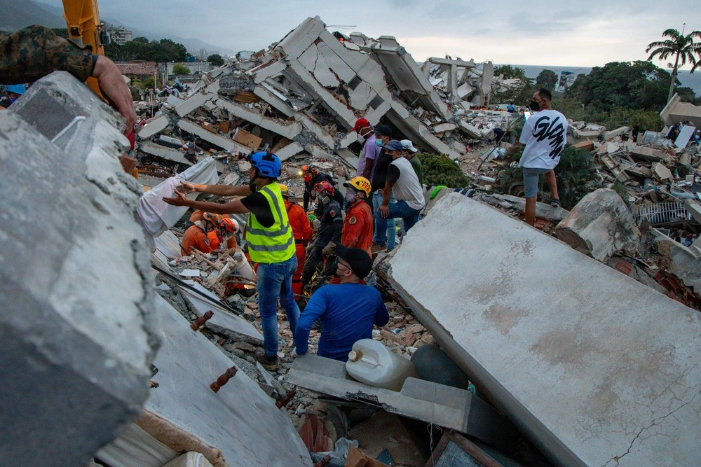
VENEZUELA, 2026
Urban Search and Rescue team members, and the people of Venezuela conduct a search and rescue in La Guaira, Venezuela, June 28, 2026.
Photo by Cpl. Daniel Garcia, 24th Marine Expeditionary Unit — U.S. Marine Corps photo, Public Domain (DVIDS)
Notes:
OPERATOR: Advance to Slide 11 (closing) as the pastor lands on: "Take heart. I am. Don't be afraid." Hold through the final paragraph and "Amen."

Slide 11
HEAR HIM
Take heart.
I am.
Don't be afraid.
Notes:
OPERATOR: Hold this slide through the closing line and "Amen." This is the last slide of the sermon — no further advance needed.

